Slide 1
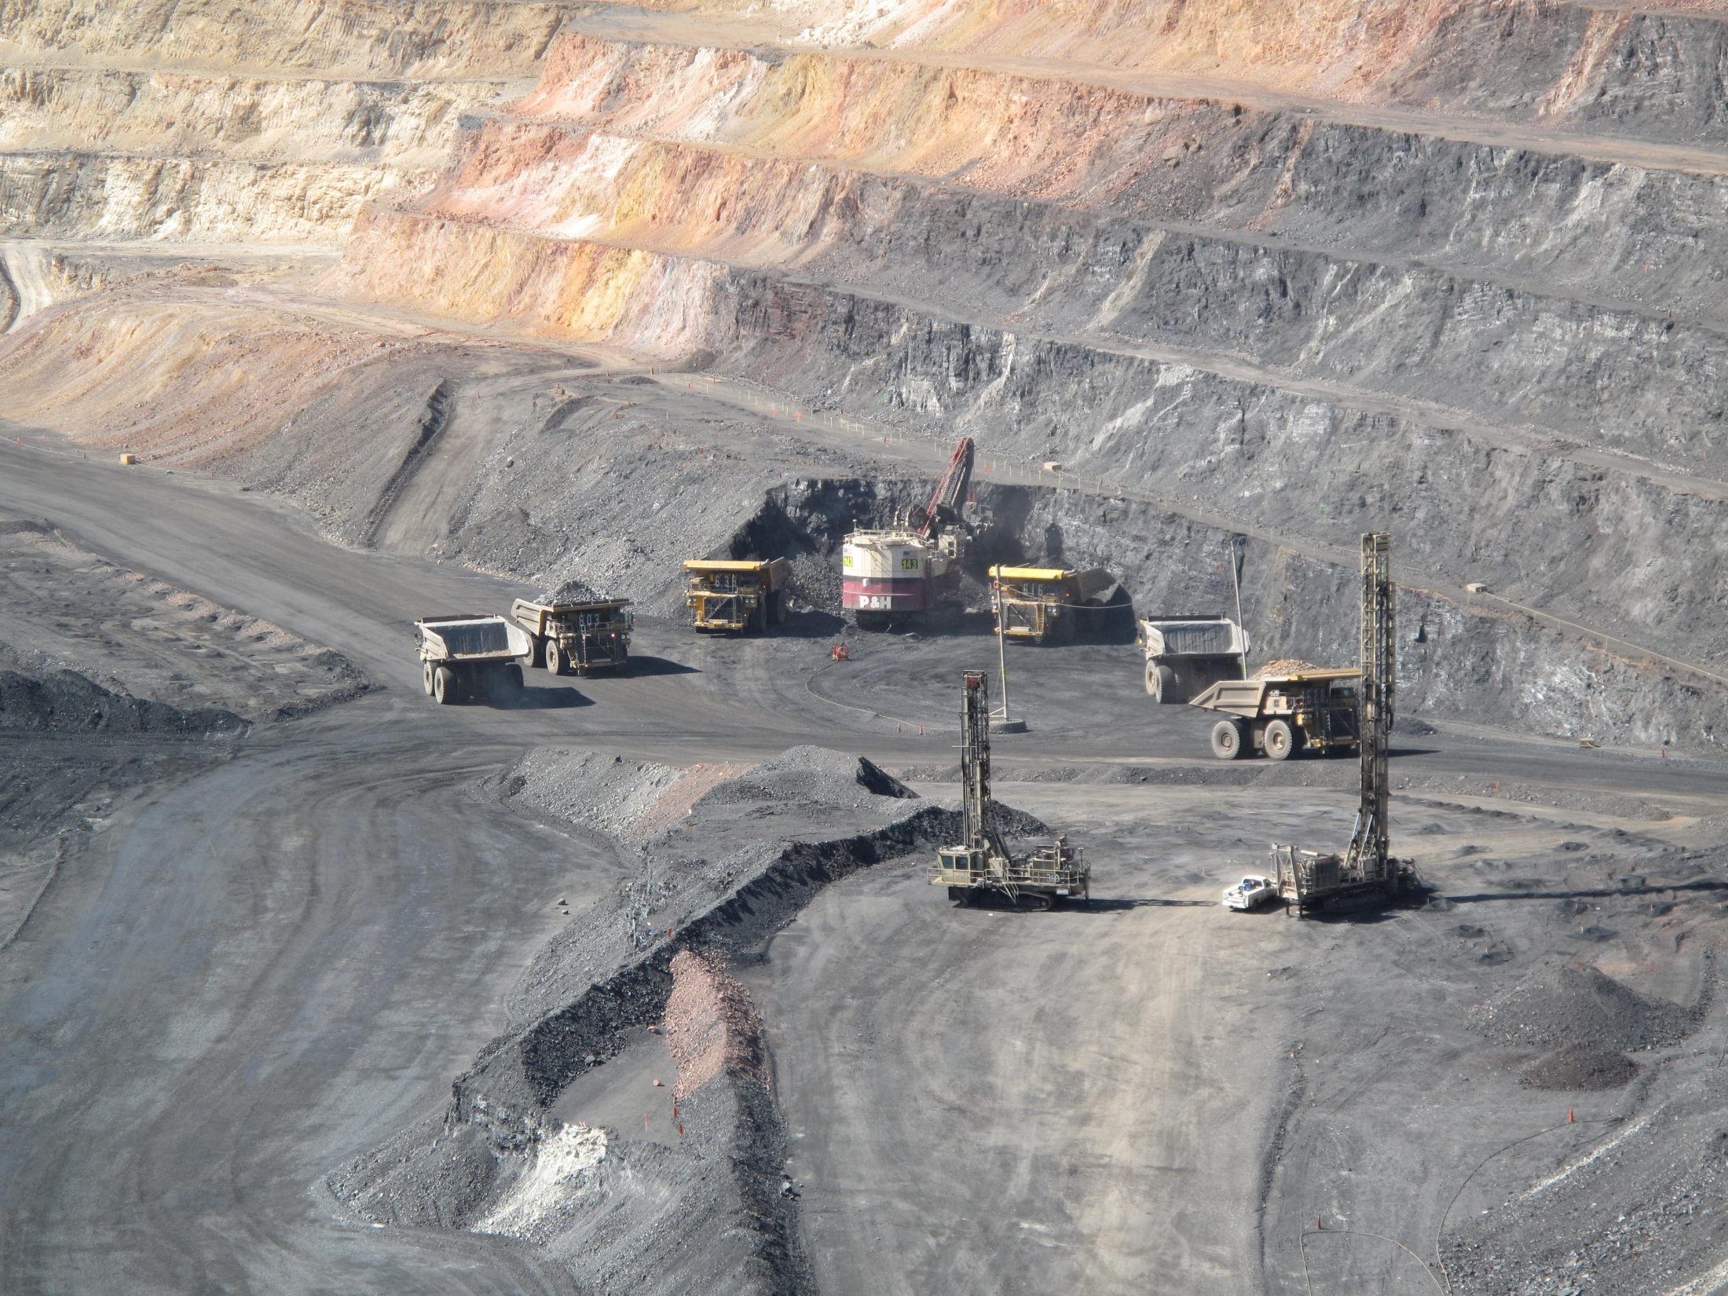
Build A Mine
Presented By:
Joe Riney
Rob Ghiglieri

Slide 2
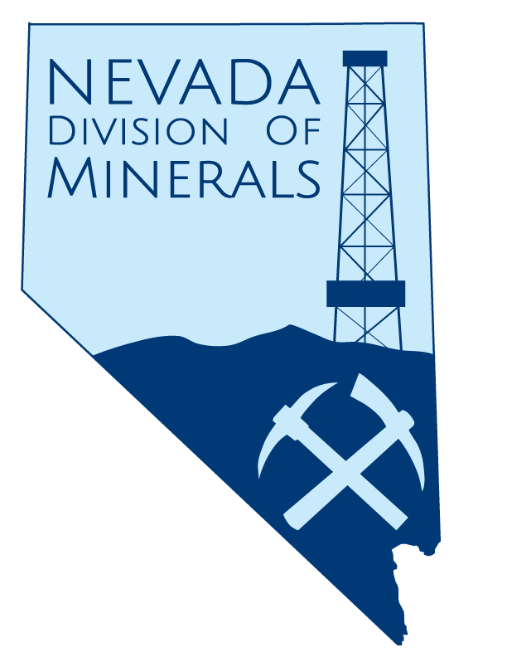
Why Do We Mine
Economics
The science that deals with the production, distribution, and consumption of goods and services, or the material welfare of humankind.
1. Production: How is this product made?
2. Distribution: Where does the product go after it is produced?
3. Consumption: How is this product used once it is sold to the general public?
Source: http://dictionary.reference.com/browse/economics

Slide 3
Types of Resources
Natural Resources:
Living and nonliving materials that come from the Earth such as fossil fuels, minerals, plants, animals, water, air, sunlight, and other forms of energy
Renewable Resources:
Nonrenewable Resources:
Naturally occurring raw materials or form of energy that has the capacity to replenish itself within a relatively short amount of time (e.g. a human lifetime) through ecological cycles and sound management practices, e.g., trees, agricultural crops, grasses.
Minerals or sources of energy that can be mined or collected from the Earth, such as coal, petroleum, iron ore, copper, etc. The processes of their formation are so slow that these resources may be considered gone forever once they are used up.
Alameda County Waste Management Authority & Alameda County Source Reduction and Recycling Board
http://www.stopwaste.org/docs/schools/Lesson01.pdf

Slide 4
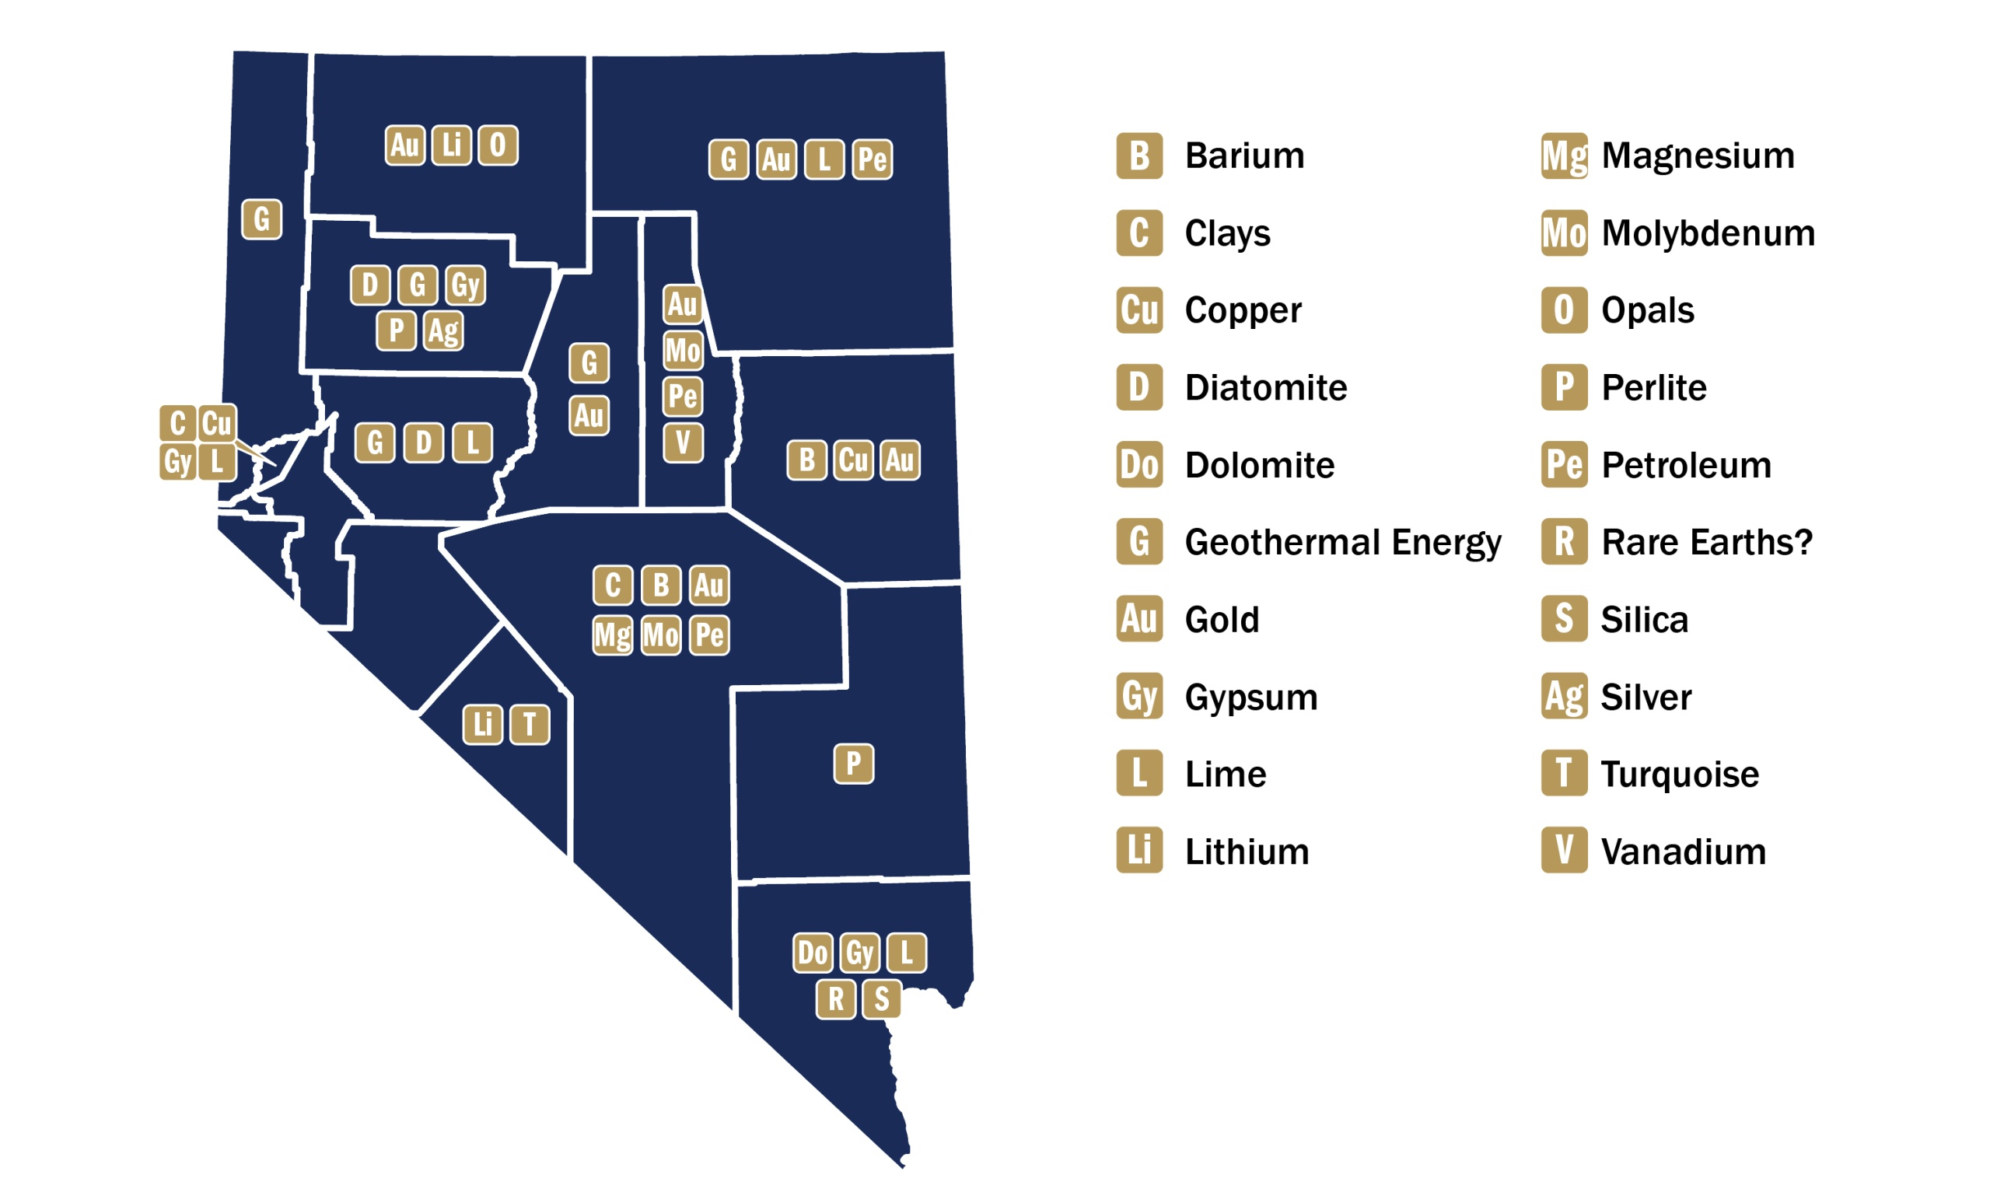
Distribution of Minerals in NV
Source:
NMA
Source:
http://minerals.usgs.gov/minerals/pubs/mapdata/precious.pdf
http://minerals.usgs.gov/minerals/pubs/mapdata/nonprec.pdf
http://minerals.usgs.gov/minerals/pubs/mapdata/agricult.pdf

Slide 5
Life Cycle of a Mine
Exploration
Permitting
Development
Extraction
Reclamation

Slide 6
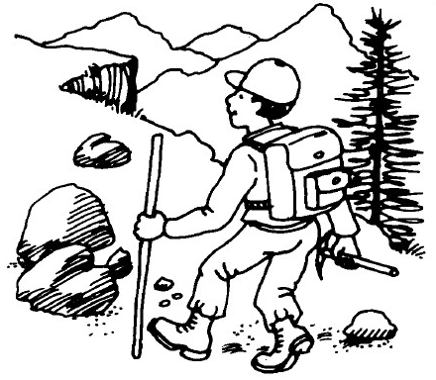
Exploration
Exploration
Geologists survey the land via geological mapping, geochemical sampling and geophysical surveys. Once they establish a target area, they drill and extract rock for analysis. If they develop a large enough mineral resource for a mine, mining engineers look at the ore deposit and determine whether the mineral resource can be extracted economically
Costs:
Claims fees
Taxes
Drilling
Facilities
Employees
Analysis
Nevada spent $309.4 million on exploration alone in 2016. That was down more than half from the $674.7 million spent in 2011
Source: NMBG Nevada Mineral and Energy Resource Exploration Survey 2015/2016

Slide 7
Permitting
BLM/Forest Service –federal lands, of which Nevada is 84.9%
Environmental Assessment
Preferred – FONSI – Finding of No Significant Impacts
Significant Impacts? Go to step 2…
Environmental Impact Statement
State permits regardless of land status
Water preservation
Air preservation
Wildlife mitigation
Storm water control
All other relevant business licenses
Private land – state permits only

Slide 8
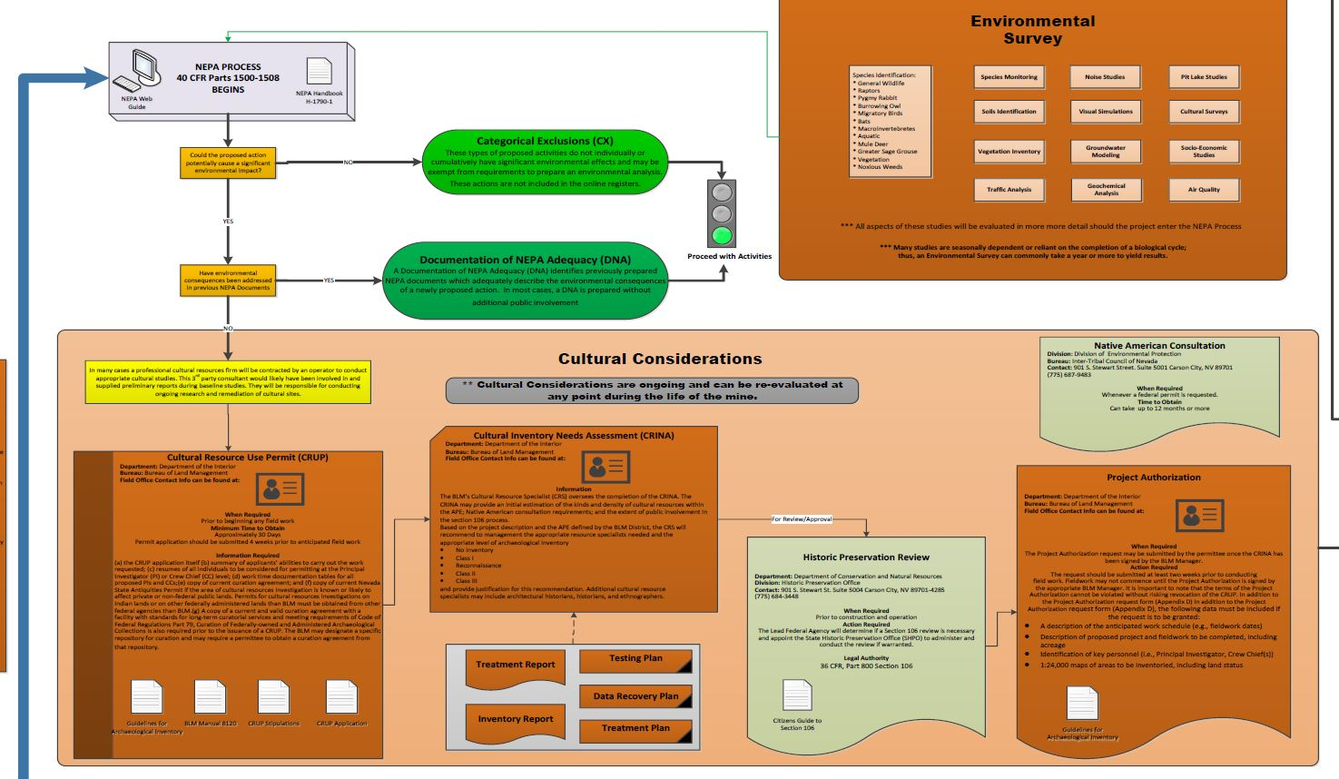
Permitting

Slide 9
Development
Factors of Production
CAPITAL
LOCATION
TYPE OF DEPOSIT
LAND
L
A
B
O
R

Slide 10
Development
LOCATION
Is the location near towns or cities?
Workforce
Infrastructure
Road
Rail
Power
Water
Public Land
Private Land
Near restricted land?

Slide 11
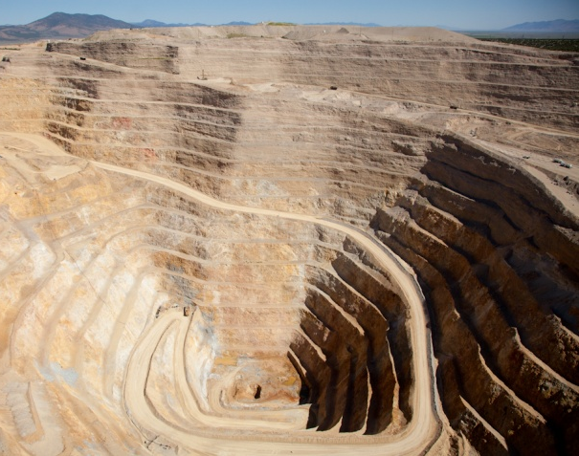
Development
Land Costs
Buying/leasing the property
Protecting the environment
Reclaiming the land
Paying taxes on the property
Permits to operate
Royalties on mineral rights

Slide 12
Development
Type of Deposit
Commodity type
Depth
Recovery Methods
Processing Required
Leach or Autoclave
Crushing
% of actual recovery
Grade of Ore
Cost per Tone

Slide 13
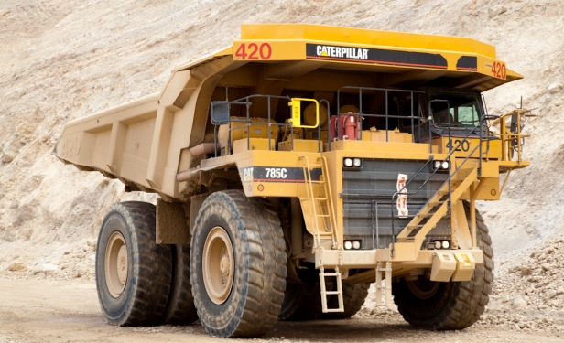
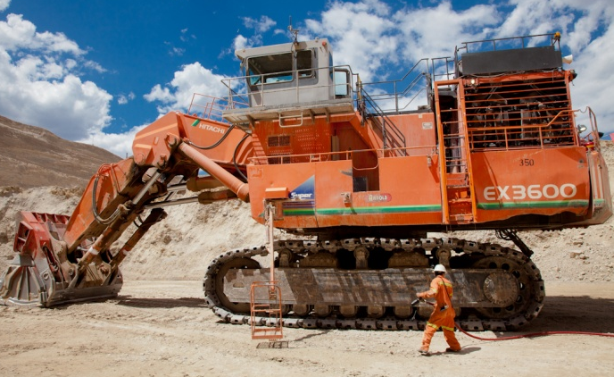
Development
Capital: Those goods produced or supplied by the economic system that are used as inputs to produce other goods and services in the future.
Did you know?
Just one of these haul trucks costs
$3 million
One shovel costs
$25 million!
Types of Capital
Infrastructure
Buildings
Equipment
A gold mining company spent
$854 million on capital expenditures in North America during the year 2011
Sources: http://www.unepscs.org/Economic_Valuation_Training_Materials/06%20Readings%20on%20Economic%20Valuation%20of%20Coastal%20Habitats/34-Economic-Valuation-Terminology.pdf
http://barrickresponsibility.com/2011/community/contributions

Slide 14
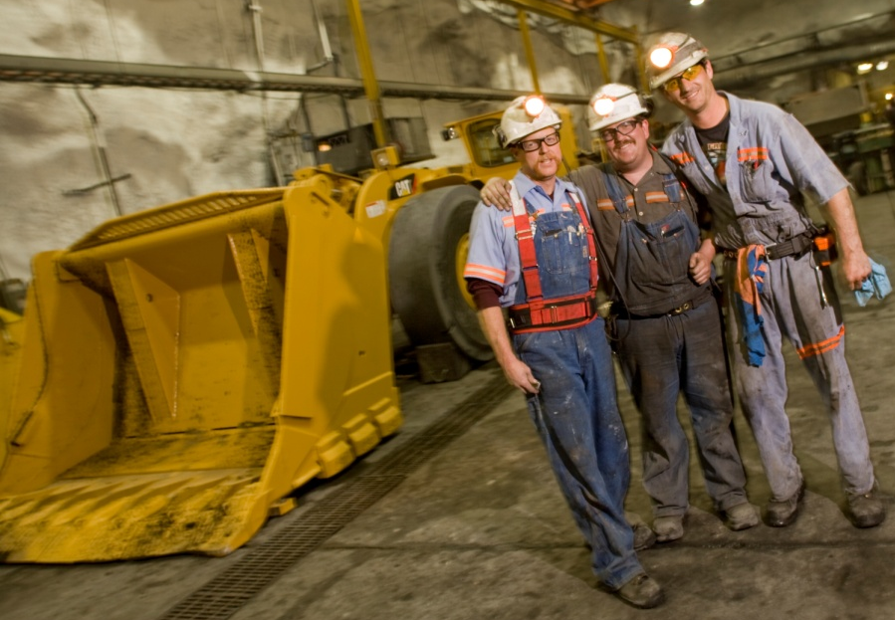
Development
Labor Costs
Employee wages
Employee benefits
Insurance
Retirement
Other
Transportation
Housing
Recruiting/Relocation

Slide 15
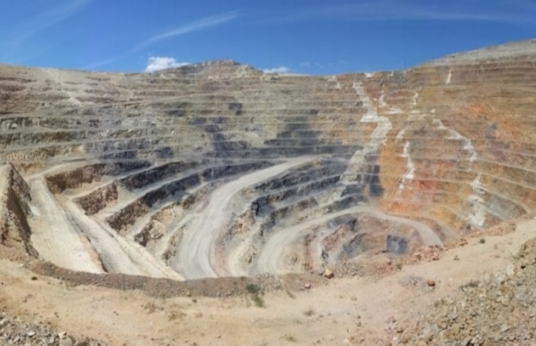
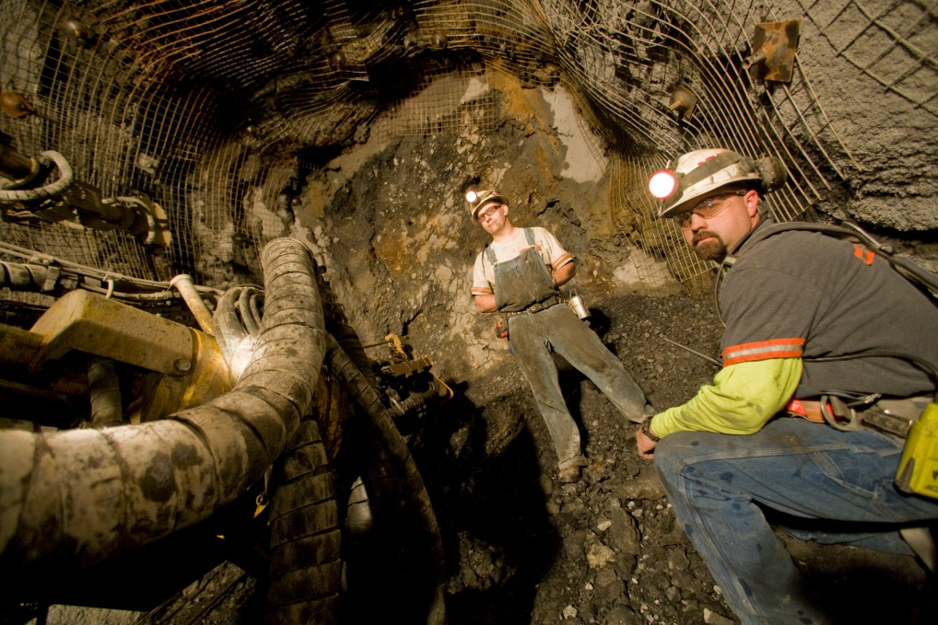
Extraction
Determined by all of the factors discussed in Development
Open Pit
Underground
or

Slide 16
Extraction
Why Underground?
Ore is deep and uneconomical to remove the overburden
Maximize ore and minimize waste
Permitting: Land/ Mineral Ownership, Environmental or Social
Transport (people, waste rock and ore) through:
Decline
Shaft
Decline and Shaft
Drifts
S
H
A
F
T
Ore Body
DECLINE

Slide 17
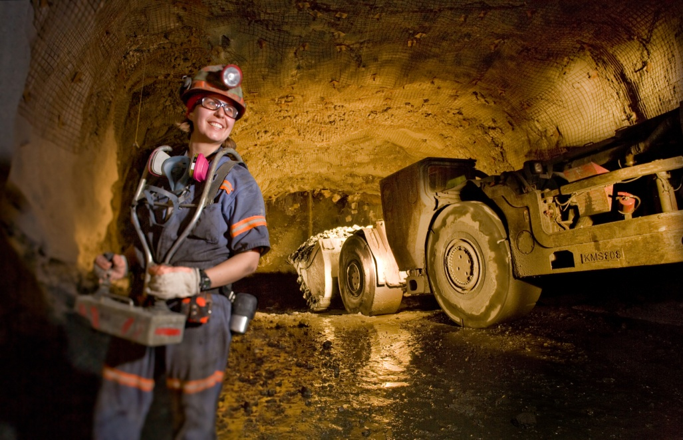
Extraction
Underground
Create access and other openings (water sump, power station, shop etc.) in waste rock.
Cycle/Round
Drilling
Blasting
Mucking
Ground Support
Basic UG Drift Terminology
Rib- Side Wall
Back- Roof Overhead
Face – Active Working/Advancing Surface
Sill- Floor
repeat

Slide 18
Extraction
Common Underground Equipment

Slide 19
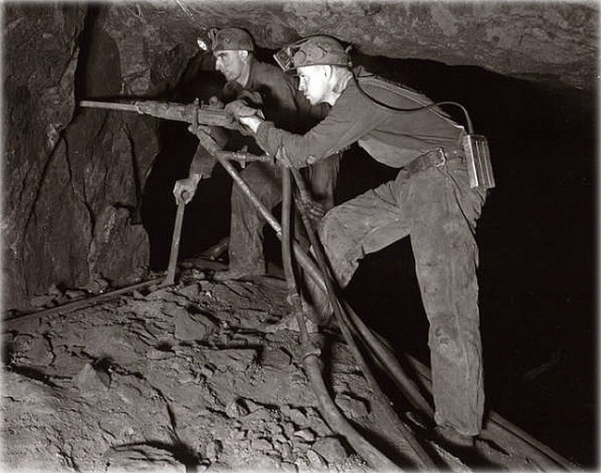
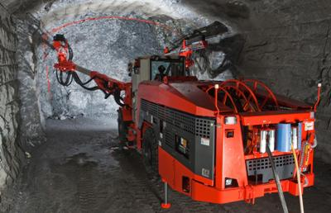
Extraction
Drilling
Then
Now
(Jackleg Drill)
(Jumbo Drill)

Slide 20
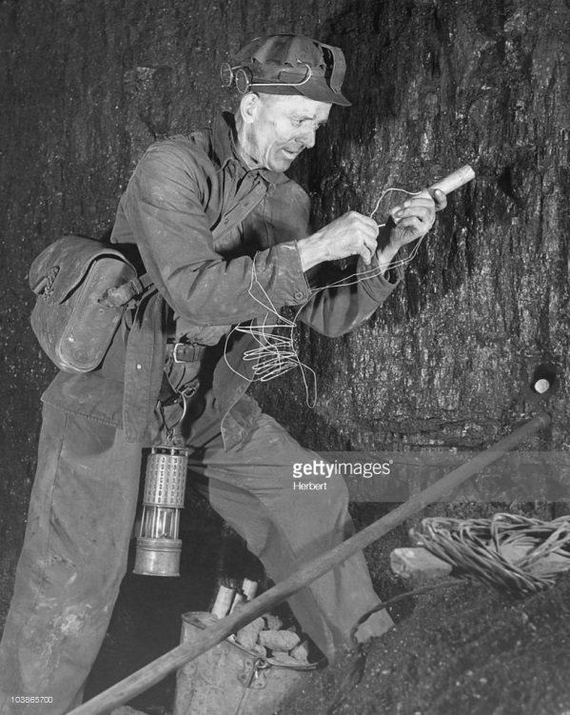
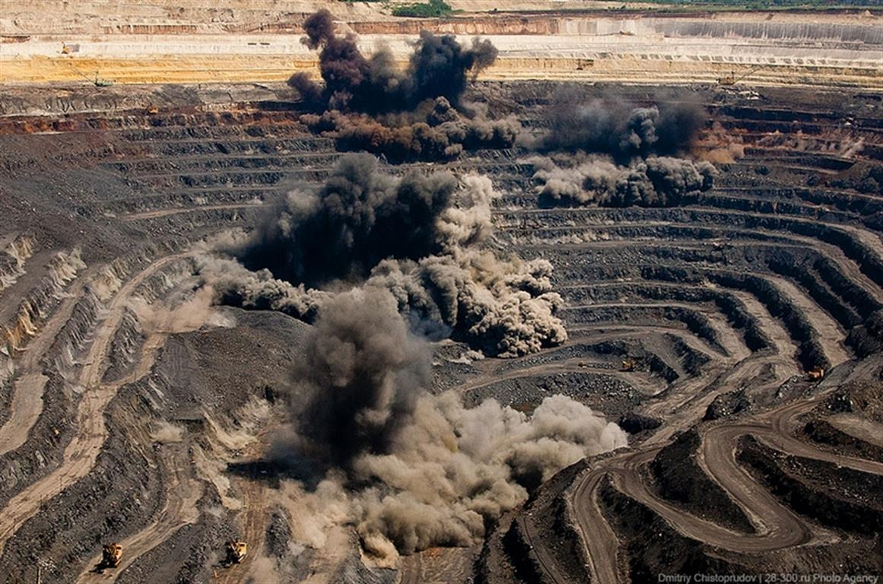
Extraction
Blasting
Then
Now
(Circa 1950’s)

Slide 21
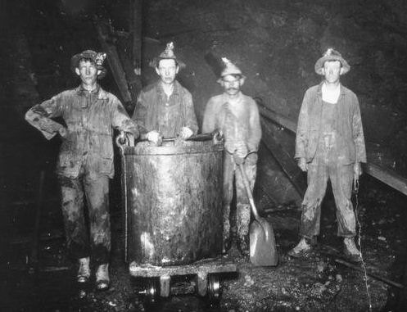
Extraction
Mucking
Then
Now

Slide 22
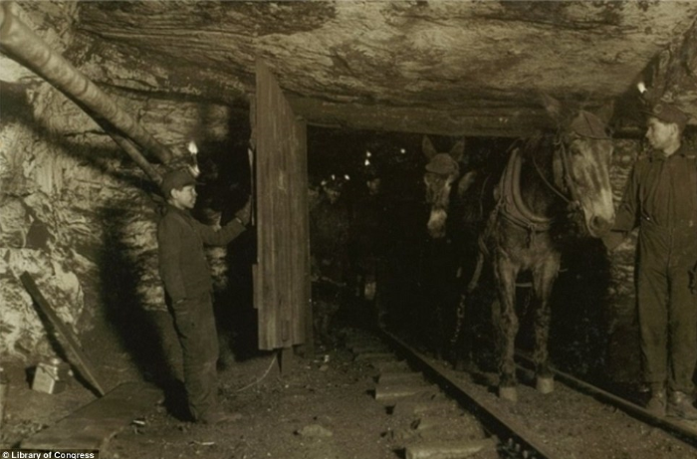
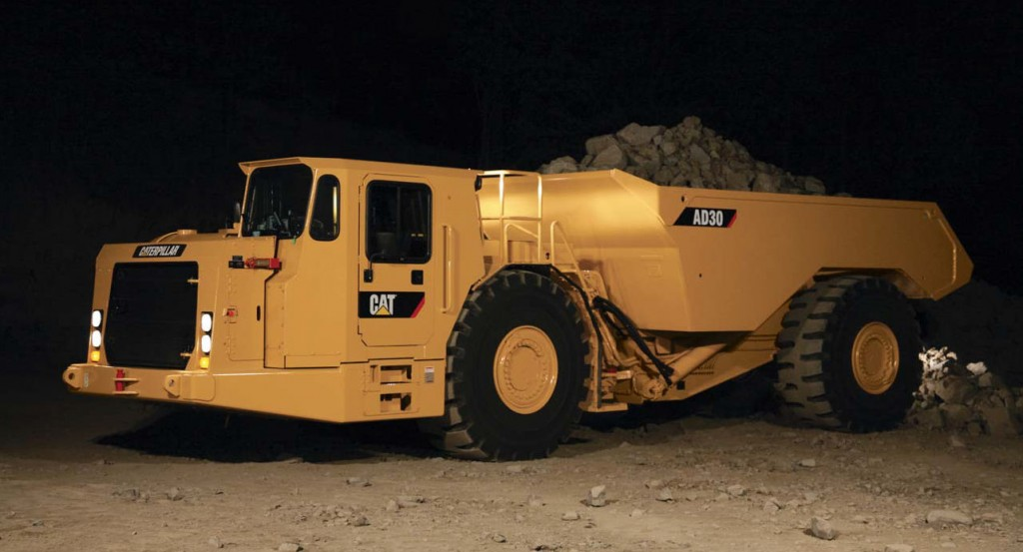
Extraction
Hauling Ore
Then
Now

Slide 23
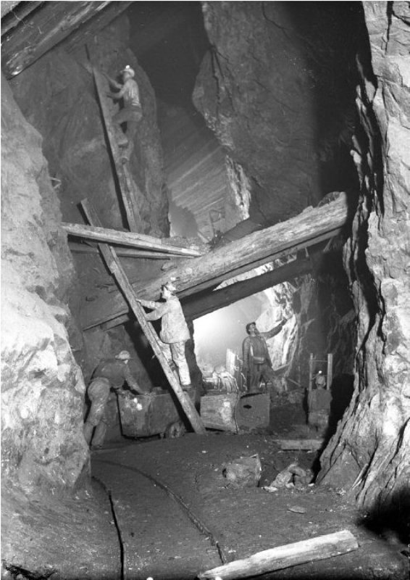
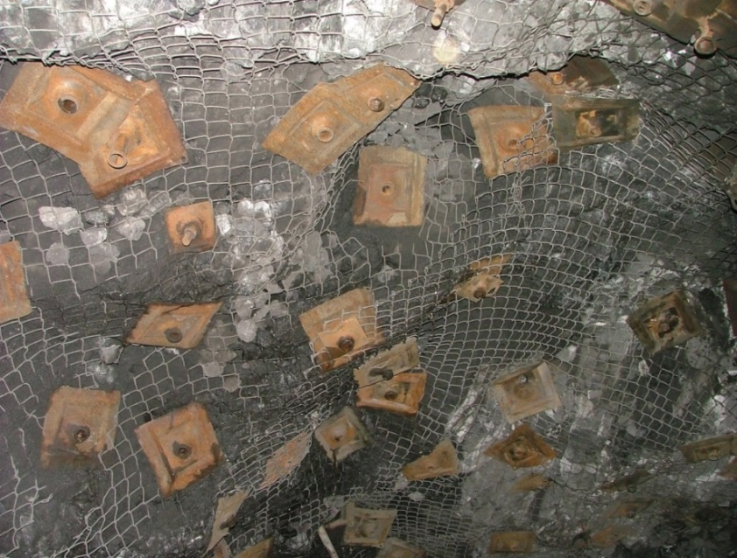
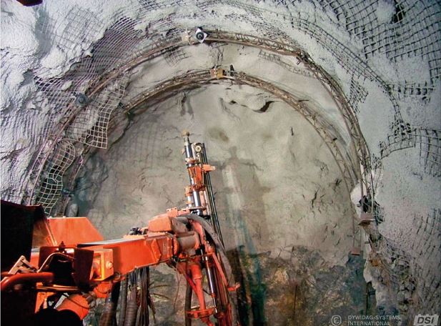
Extraction
Ground Support
Then
Now

Slide 24
Extraction
Why Open Pit?
Ore is shallow and is economical to remove the overburden
Reduce operation costs
Lower grade deposit
Transport (people, waste rock and ore) by:
Haul Trucks
Light Utility Vehicles
Shovels
Conveyors
Ore Body
Pit Outline

Slide 25
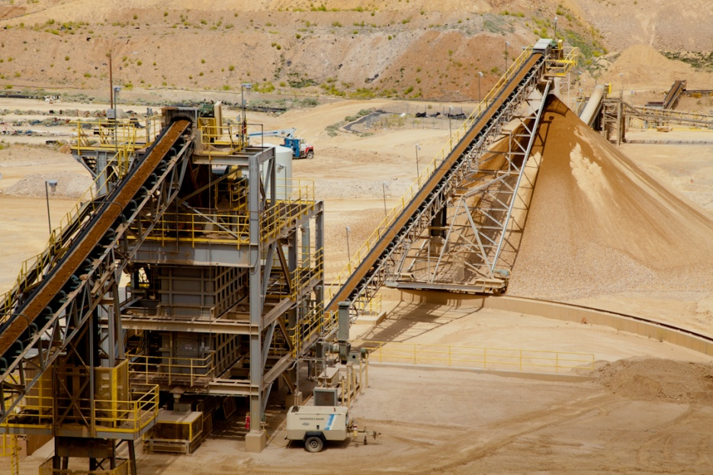
Extraction
Processing Methods
Leach Pads
Crushed
Run of Mine
Mill/Autoclave
Roasting
Smelting

Slide 26
Extraction: Cyanide Usage
Cyanide is a molecule made up of two common elements, Carbon and Nitrogen (CN)
Most effective process for extracting gold and silver out of the ore
Solid sodium cyanide is ideal for shipping as it is nearly 100% cyanide and is therefore more economically transported. Once at a mine site, dry cyanide must be dissolved in order to be applied to the process.
Manufactured for the mining industry, typically as sodium cyanide in either solid or liquid form
Notes:
Occurs naturally in many substances and may also be released as hydrogen cyanide by burning plastics
Liquid sodium cyanide (30%) has become the product of choice where available. It is delivered to mine sites in a usable solution and loaded directly into their storage tanks.

Slide 27
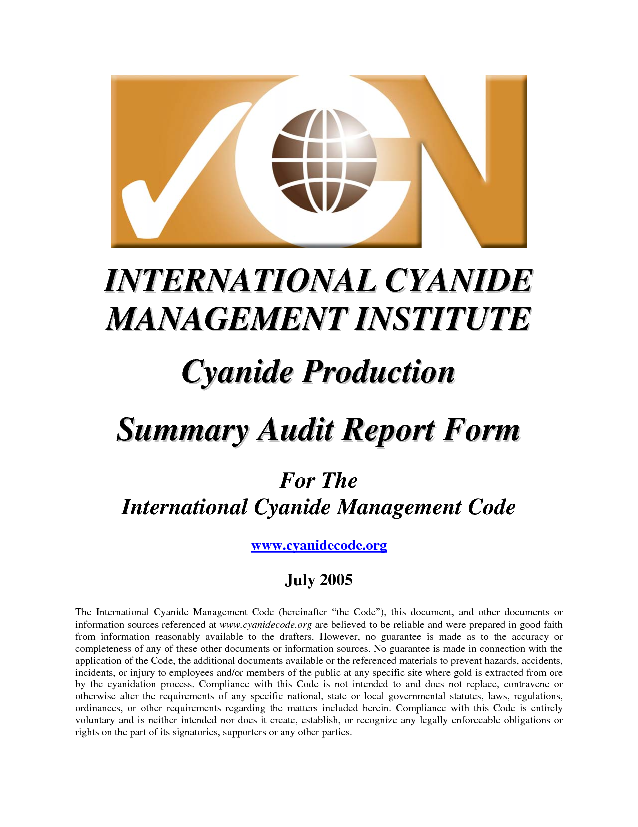
Extraction: Cyanide Management
Mine sites dilute the 30% cyanide solution approximately 1000:1 or more with water when applying it to a leach pad.
While cyanide is a very toxic substance it is highly controlled in the manufacturing and mining industries and has an enviable safety record.
Cyanide poisoning is reversible with the use of a cyanide antidote kit.
Cyanide breaks down readily in the presence of air and sunlight.

Slide 28
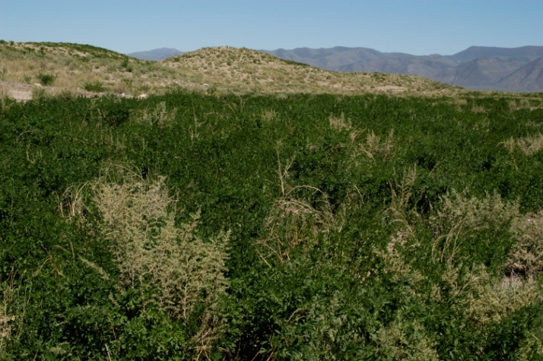
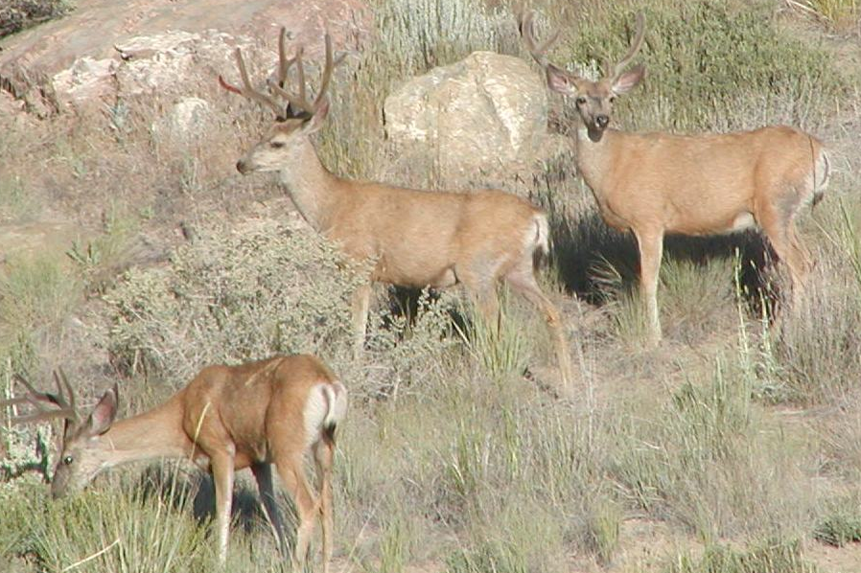
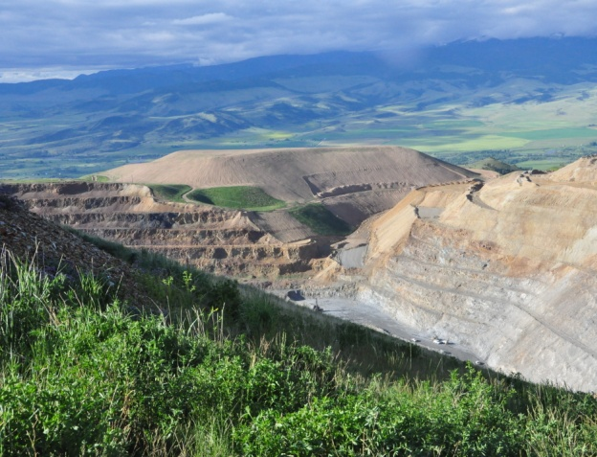
Reclamation and Closure
Closure and reclamation follow strict detailed plans and requirements, created to meet company and regulatory agency standards
Reclamation includes steps like habitat restoration – planting vegetation that grows naturally in the area to encourage wildlife to return

Slide 29
Wildlife Protection & Conservation
Mining companies apply many measures to conserve and protect wildlife and wildlife habitat from physical or chemical harm resulting from their operations.
Many times companies take specific steps to lessen unavoidable impacts and even enhance habitat near the mine to offset impacts occurring within the mine area itself.
Source: http://www.nevadamining.org/issues_policy/land_use.php

Slide 30
Reclamation Regulations
Before any ground is disturbed, mining companies must ensure that adequate funds are available to complete reclamation and remediation of exploration and mining sites.
In order to close, the mining company must:
Submit a form 2 years before closure
Submit another form at closure time
Monitor the area for a minimum of 5 years
Source:
http://ndep.nv.gov/BMRR/clshome.htm
http://www.nevadamining.org/issues_policy/land_use.php

Slide 31
Regulation
Federal
State
US Department of Justice
US Department of Interior
Bureau of Land Management
Fish and Wildlife Service
US Department of Labor
Mine Safety & Health Administration
US Department of Agriculture
U.S. Forest Service (if on USFS lands)
US Army Corps of Engineers
Activities in wetlands and or waters of the U.S.
Commission on Mineral Resources
Department of Business and Industry
Department of Conservation and Natural Resources
Bureau of Air Pollution Control
Bureau of Corrective Actions
Bureau of Mining Regulation and Reclamation
Bureau of Waste Management
Bureau of Water Pollution Control
Bureau of Safe Drinking Water
Division of Water Resources
Department of Wildlife
Department of Human Resources
Department of Motor Vehicles and Public Safety
Department of Transportation
City/County Requirements
Building Permit
Business License
General Plan
Special Use Permit
Zoning Change

Slide 32
Reflection
Today’s Activities/Classes
Standards
Adaptations
Questions?

