Slide 1
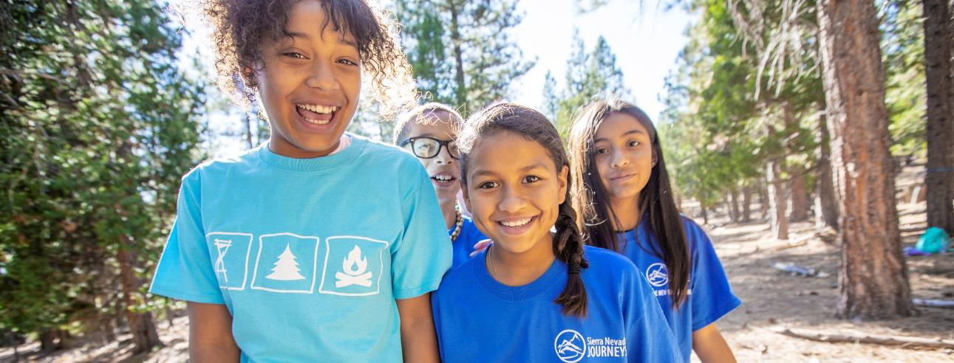
Erosion Experience Instructor: Alyssa Wagner, alyssaw@sierranevadajourneys.org

Slide 2
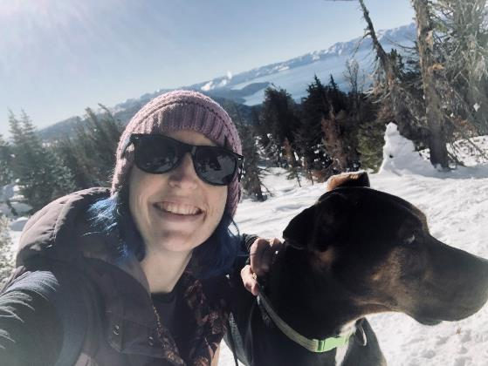
About Me
Classroom teacher for 8 years
Taught kindergarten, 2nd grade, and 6th grade
Joined Sierra Nevada Journeys in 2019
I love hiking, camping, and snowshoeing
Notes:
Welcome everyone. My name is Alyssa Wagner and I am the Reno Program Director with Sierra Nevada Journeys. A bit of background on me - I was born and raised in Reno and have lived there most of my life. I love getting outside as much as possible.
I was a classroom teacher for 8 years teaching 6th grade, kindergarten, and 2nd grade. Then I decided to leave the classroom and joined Sierra Nevada Journeys where I get to focus on my two favorite parts of teaching: science and field trips. I have been with Sierra Nevada Journeys since 2019.
Anyone familiar with Sierra Nevada Journeys? For those of you who are not, we are an environmental education non-profit based in Reno, Sacramento, and Portola. We bring science into the classroom and then take kids on field trips to get first hand experience with the concepts we teach. We also provide family events where we bring hands-on STEM activities for families to participate in. We also have over night and summer camp up in Portola.

Slide 3
Adjusting lesson for different grade levels
4-ESS2-1 – Make observations and/or measurements to provide evidence of the effects of weathering or the rate of erosion by water, ice, wind, or vegetation.
Disciplinary Core Idea across the grades:
2-ESS2-1 – Compare multiple solutions designed to slow or prevent wind or water from changing the shape of the land.
5-ESS2-1 – Develop a model using an example to describe ways the geosphere, biosphere, hydrosphere, and/or atmosphere interact.
Notes:
We can discuss adjusting these activities at the end, once you all have had a chance to participate in them. But here are some quick notes
This lesson was designed for fourth graders. It was backwards designed from this NGSS Earth Science standard. The DCI that it connects to in other grade levels is 2nd grade & 5th grade. In kinder, 1st, and 3rd students are more focused on weather. However, you could tie this experiment to how weather would change the rate the sediment moves.

Slide 4
Anchoring Phenomenon
What questions do you have and what do you already know?
Describe what happened/is happening in this picture in your own words.
Notes:
To begin this unit we introduce students to this picture. It is a picture from our field trip of a granite rock that has been split. We begin by having students write down what questions they have about the picture, what they already know, and challenge them to describe what is happening in this picture.
This is to get them started thinking about how the landscape changes over time.

Slide 5
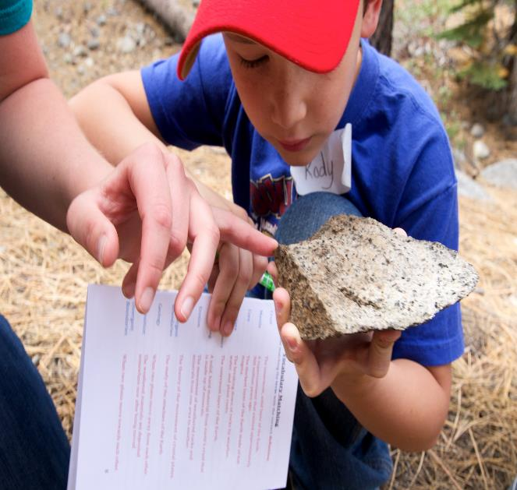
Essential Question
What causes more or less sediment to move?
Objective
Students will be able to use observations and measurements to provide evidence to support a claim about factors that increase or decrease the rate of erosion.
Notes:
This experiment will get students answering “What causes more or less sediment to move?”

Slide 6
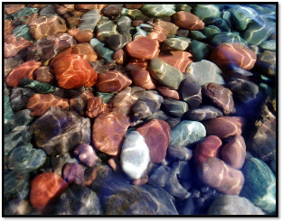
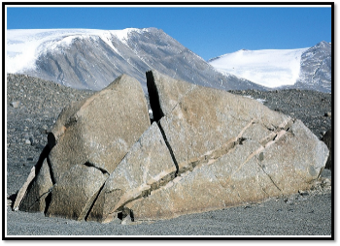
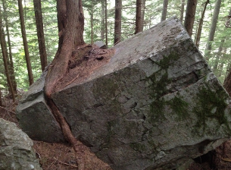
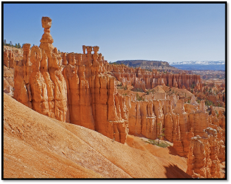
Physical Weathering Examples
Notes:
Looking at these photos, how do you think each of these were weathered? With students we would provide them the types of physical weathering. With students a great way to do this exploration is to provide your table groups with a set of these pictures and have them decide how each was weathered and then whole class have them vote by holding up their pictures. Then discuss their reasoning like we did in our discussion.

Slide 7
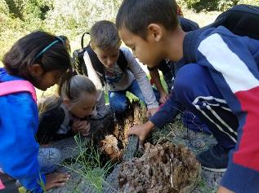
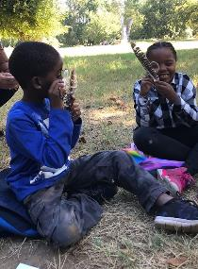
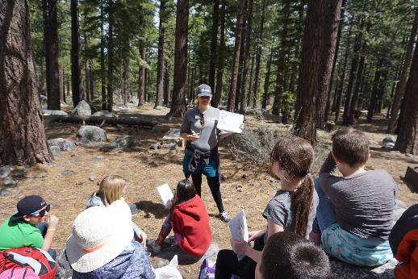
How to identify the type of weathering
Wind – carved, formed
Water – smooth, rounded
Freeze-thaw – straight crack(s)
Vegetation – jagged crack(s)
Notes:
You can have them draw a picture of this in their science notebook as a reminder of what they look like and have them add these quick descriptions.

Slide 8
Weather your “rocks”
Which type of weathering would you like to demonstrate?
Don’t tell anyone around you.
Form your rock.
Have the folks around you guess what type of weathering you are demonstrating.
Notes:
We also have a whole body definition we use for weathering: weathering is the breaking down of rocks and minerals into tiny pieces called sediment. Once they know that definition you can move into erosion or how sediment moves.

Slide 9
Weathering
Weathering is the breaking down of rocks and minerals into tiny pieces of sediment.

Slide 10
Sediment
Supplies:
Plastic cup with lid
2-3 volcanic rocks
Shake the container for about 1 min.
What do you notice?

Slide 11
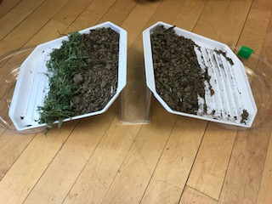
Setting up the experiment
Teams of 4 – one pair will make sediment move more and the other pair will make sediment move less
Supplies:
2 trays for dish drying rack
1 napkin holder
2 plant tray/saucer
Soil (small cup per pair)
Plastic cups (1 for water, 1 for soil per pair)
Water
Rocks, plant matter, etc.
Notes:
Now lets get to the fun part and get our hands dirty. For this experiment you’ll be working in teams of 4. In your classroom I don’t recommend teams larger than 5. In my experience 4 is the sweet spot, more students and they get off task quickly and fewer students and they struggle with the number of moving parts.
I will come around and hand out your supplies for this experiment. One note, it is challenging to locate these white trays in this size anymore. Most are much larger, that works just as well you’ll just need larger plant saucers.
Let’s discuss the different variables you all can change during this experiment. We created the following slides for students. Depending on the needs of the class you can let the students decide on what variables they would like to change or you can print these out and give each group of 4 one card to have a more controlled experiment or to provide scaffolding for students.

Slide 12
SPEED of water Both sides should have the same slope. Pour the same amount of water, in the same spot. BUT, pour one cup FAST, and one SLOW. You need: - one napkin holder - two round trays - two rectangle trays - two cups

Slide 13
AMOUNT of water Both sides should have the same slope. Pour the water at the same speed, in the same spot. BUT, one cup has LESS water, and one has MORE. You need: - one napkin holder - two round trays - two rectangle trays - two cups

Slide 14
ROCKS Both sides should have the same slope. Pour the same amount of water, at the same speed, in the same spot. BUT, one side has ROCKS and one has NO ROCKS. You need: - rocks - one napkin holder - two round trays - two rectangle trays - two cups

Slide 15
VEGETATION Both sides should have the same slope. Pour the same amount of water, at the same speed, in the same spot. BUT, one side has PLANTS and one has NO PLANTS. You need: - dead plant material - one napkin holder - two round trays - two rectangle trays - two cups

Slide 16
SLOPE Pour the same amount of water, at the same speed, in the same spot. BUT, one side is more STEEP and the other more FLAT. You need: - two napkin holders - two round trays - two rectangle trays - two cups
One napkin holder is sideways to create a flat slope

Slide 17
Let’s get testing!
With your group decide on which pair will be making more sediment move and which pair will be making less sediment move.
Once you have decided on that, then decide on what variable you would like to change to make more or less sediment move.
Start testing!
Notes:
I won’t be assigning you all variables. I want to give you the opportunity to test multiple times and multiple variables.
*Set timer, determine based on how much time is left in session*
Once you have finished testing please draw a picture of your test and describe it in words. Since this is a science experiment please be sure to label your drawings. –We ask students to do the same. A good way to support students in their science journal skills is to show them examples or real scientist journals so that they can see how different they can be.

Slide 18
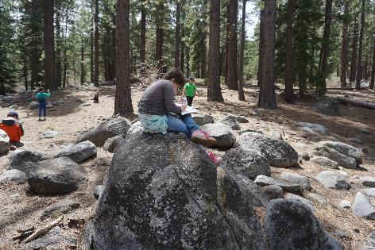
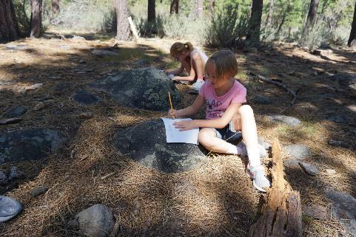
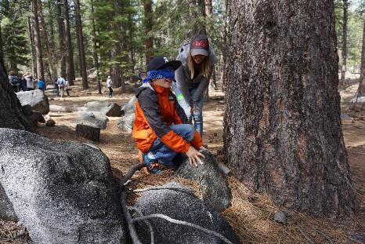
Discussing results
What did you notice about how you were able to make your sediment move more or less?
Notes:
I will collect your materials over her. Please rinse off your trays and then place them in the stack. Don’t worry about them being wet.
Now let’s discuss what we saw happen. To begin this discussion with students I ask “What did you notice about how you were able to make your sediment move more or less?” Begin with a more broad question to get students talking, then as they hone in on ideas you can narrow down the discussion.
During this discussion it is important to have students explain their reasoning or provide evidence to support their claims.

Slide 19
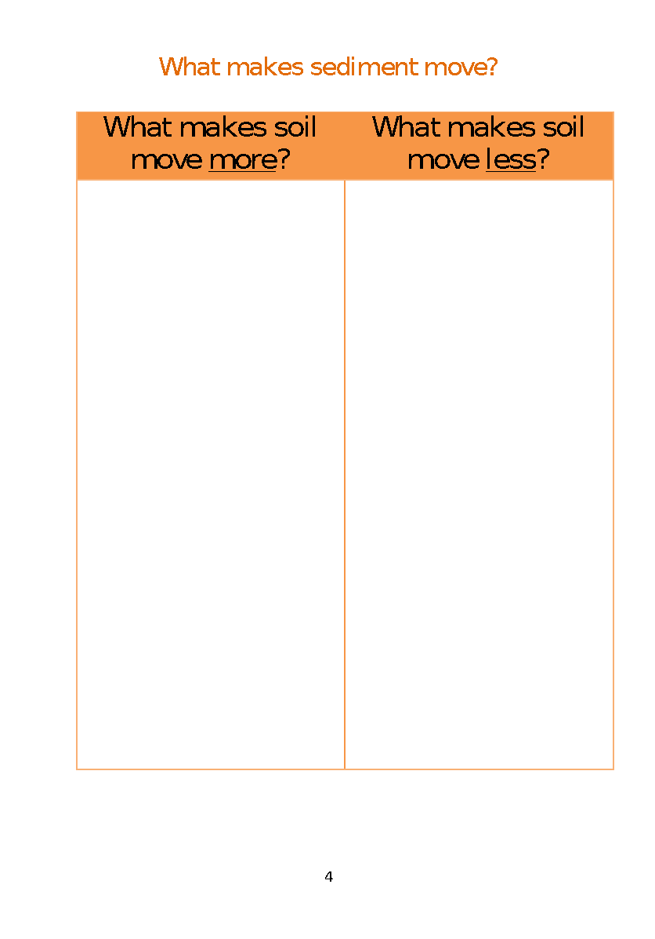
Recording results
Notes:
During this discussion you can write this T-chart on the board and record their findings. We also have students follow along and record what the class discovered. So what did you all notice?
More – more water, water moving faster, steeper slope, nothing on top of sediment.
Less – slope is flatter, no slope, less water, slower water, items on top of sediment, vegetation
That is the erosion activity. Questions? Or we can discuss how to use this for different grade levels.

Slide 20
Erosion -
Erosion is the movement of sediment from one place to another.
Deposition-
Deposition is when sediment is carried by wind, water, or ice and deposited in a new location.

Slide 21
Sediment Tag
Similar to sharks and minnows
Sharks are seed planters
Minnows are pieces of sediment
Round 1 – 1 seed planter
Round 2 – 2 seed planters
Round 4 – 3 seed planters
Once you are tagged you become a tree and your arms are your roots. You cannot move around but your job is to catch sediment with your roots.
Notes:
An extension of this activity is sediment tag.
Let’s head outside and play a round or two if we have time.

Slide 22
Anchoring Phenomenon
Now that we have learned about weathering and erosion how would you explain what happened to this rock or what is happening in this picture?
Notes:
To begin this unit we introduce students to this picture. It is a picture from our field trip of a granite rock that has been split. We begin by having students write down what questions they have about the picture, what they already know, and challenge them to describe what is happening in this picture.
This is to get them started thinking about how the landscape changes over time.

Slide 23
Adjusting lesson for different grade levels
4-ESS2-1 – Make observations and/or measurements to provide evidence of the effects of weathering or the rate of erosion by water, ice, wind, or vegetation.
Disciplinary Core Idea across the grades:
2-ESS2-1 – Compare multiple solutions designed to slow or prevent wind or water from changing the shape of the land.
5-ESS2-1 – Develop a model using an example to describe ways the geosphere, biosphere, hydrosphere, and/or atmosphere interact.
Notes:
Now that we have done the activities we can discuss how to adjust this for different grade levels or differentiating it for different student needs.

